Slide 1
SMS SPAM CLASSIFIER
Nikhil Agrawal
U73346782

Slide 2
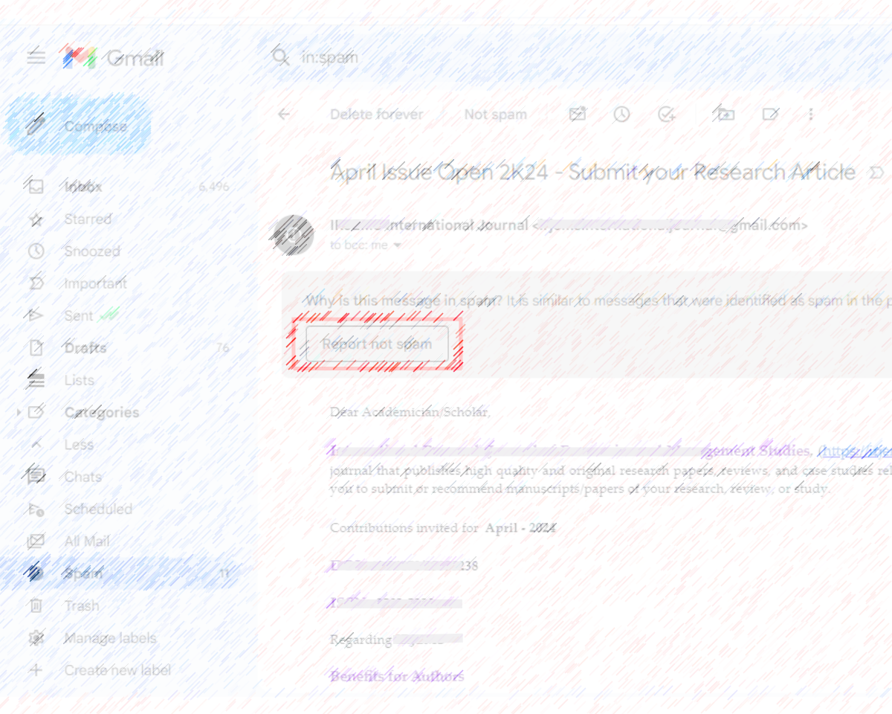
Have you ever wondered how your SMS and emails are automatically classified as SPAM or NOT SPAM?

Slide 3
ABOUT THE DATASET
The dataset used in this analysis is the SMS Spam Collection Dataset, sourced from Kaggle. .
The SMS Spam Collection is a set of SMS tagged messages that have been collected for SMS Spam research. It contains one set of SMS messages in English of 5,574 messages, tagged according being ham (legitimate) or spam.
The files contain one message per line. Each line is composed by two columns: v1 contains the label (ham or spam) and v2 contains the raw text.
Link - https://www.kaggle.com/datasets/uciml/sms-spam-collection-dataset

Slide 4
Steps
1. Data Cleaning
2. Exploratory Data Analysis
3. Data Preprocessing
4. Model Building
5. Evaluation
6. Testing Final Model

Slide 5
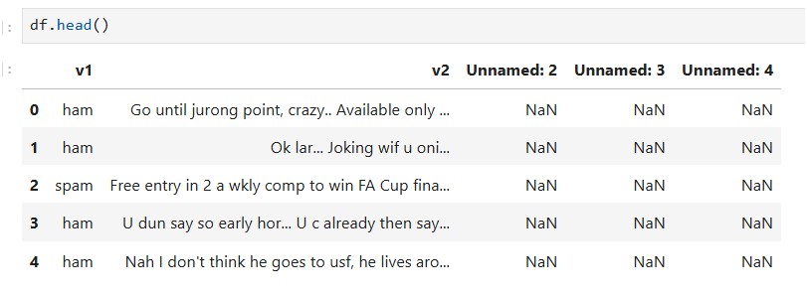
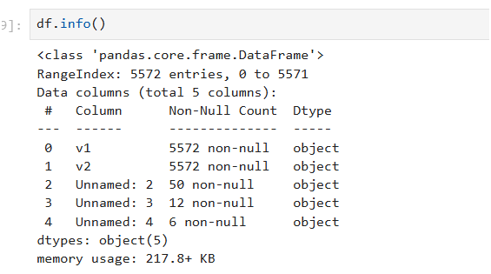
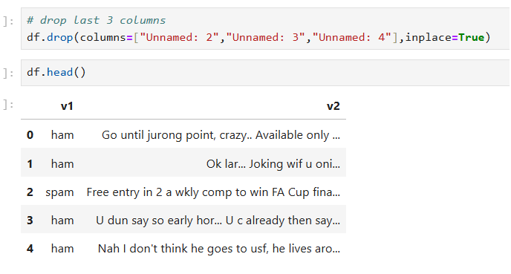
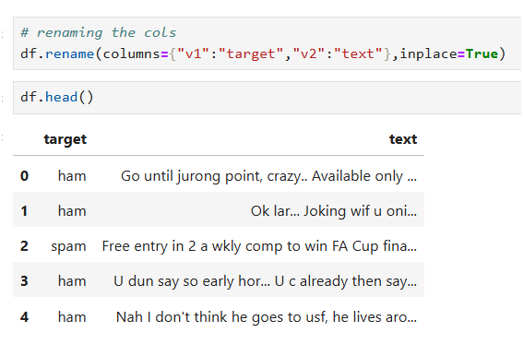
Data Cleaning
The dataset structure was examined to identify unnecessary columns. The columns Unnamed: 2, Unnamed: 3, and Unnamed: 4 were removed. Additionally, columns were renamed for better clarity: target to indicate spam or ham and text to contain the message content.

Slide 6
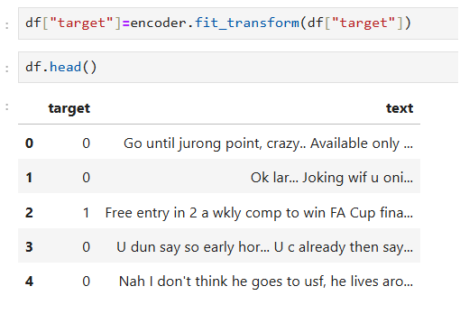
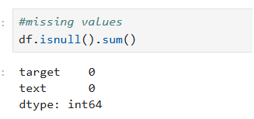
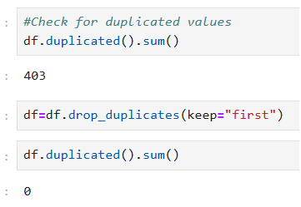
Performed label encoding to convert the categorical values in the target column into numerical values, where 'ham' was encoded as 0 and 'spam' as 1, making the data suitable for analysis and machine learning models.
I checked for missing and duplicated values in the dataset. No missing values were found, ensuring data completeness. However, there were 403 duplicated entries, which were removed using the drop_duplicates method to maintain data integrity and avoid redundancy.

Slide 7
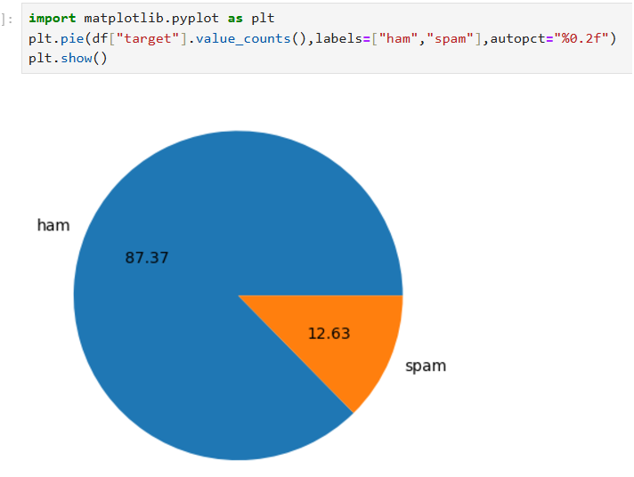
Exploratory Data Analysis
The pie chart illustrates the distribution of messages in the dataset. Approximately 87.37% of the messages are labeled as "ham" (not spam), while 12.63% are categorized as "spam". This highlights an imbalanced dataset where most messages are non-spam.

Slide 8
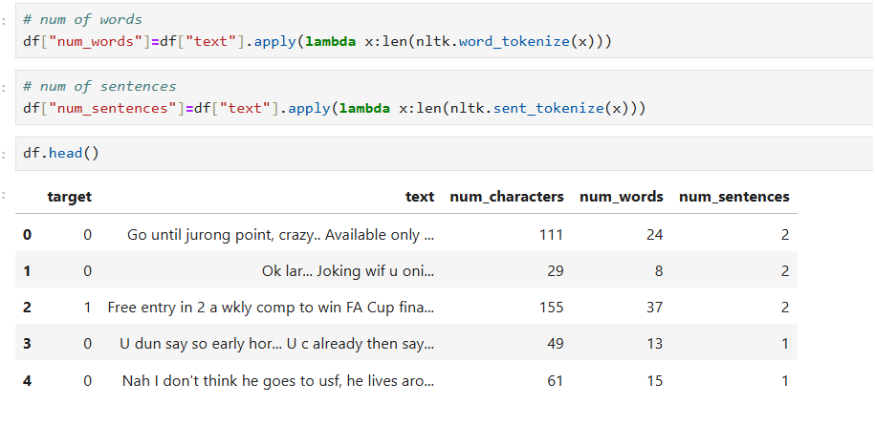
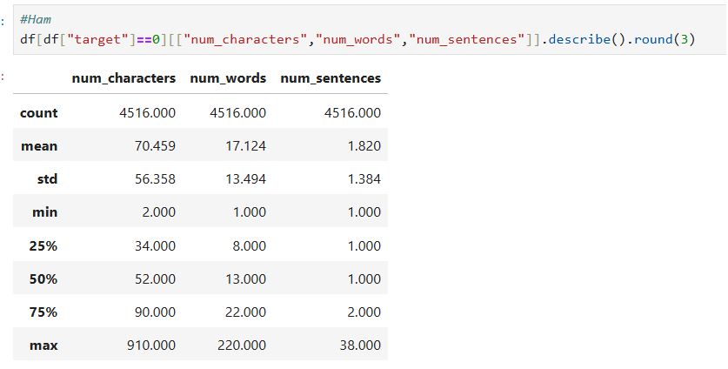
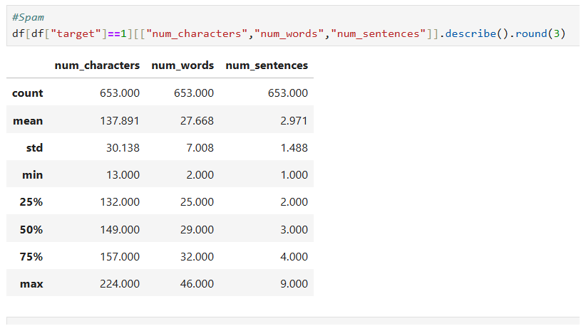
Ham messages are generally shorter with an average of 70 characters and 17 words, while spam messages are longer, averaging 138 characters and 28 words, highlighting the verbosity of spam content.

Slide 9
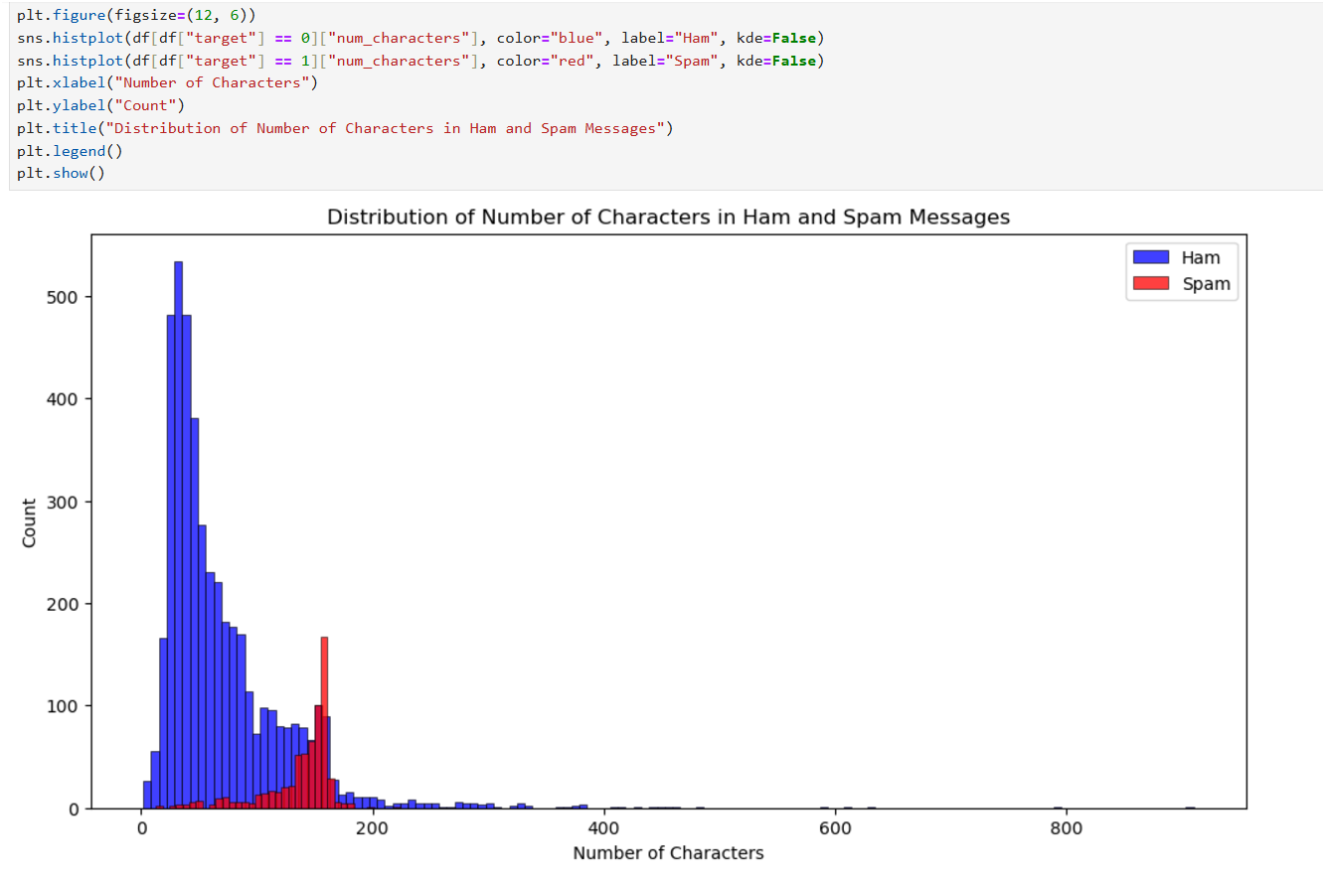

Slide 10
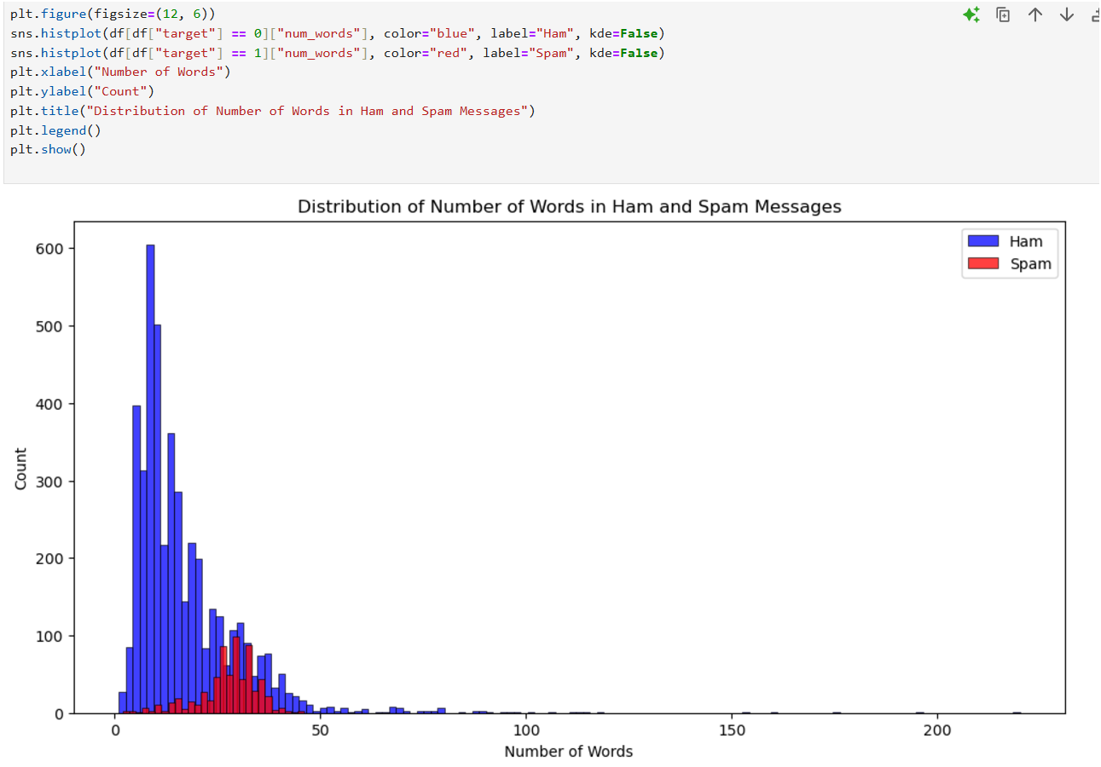

Slide 11
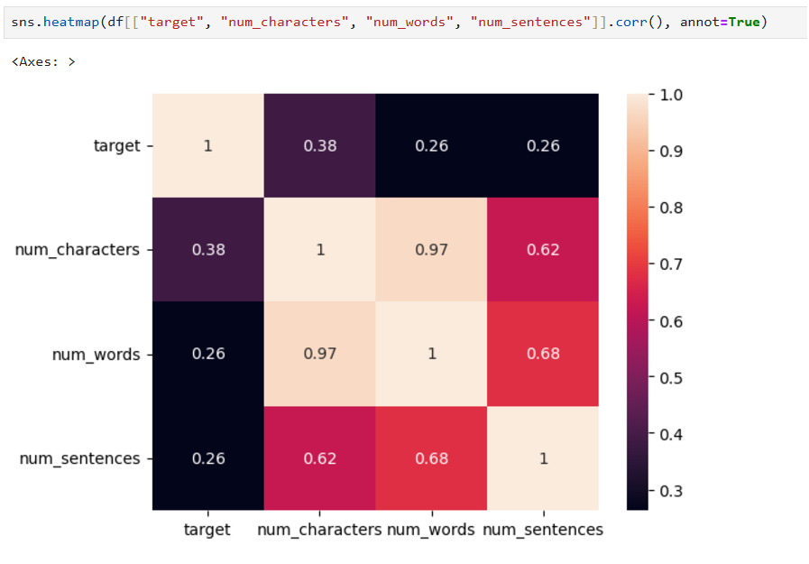

Slide 12
Data Preprocessing
Data Preprocessing involves preparing raw data to make it suitable for analysis and modeling.
1.Lower Case
2.Tokenization
3.Removing special characters
4.Removing stop words and punctuation
5.Stemming

Slide 13
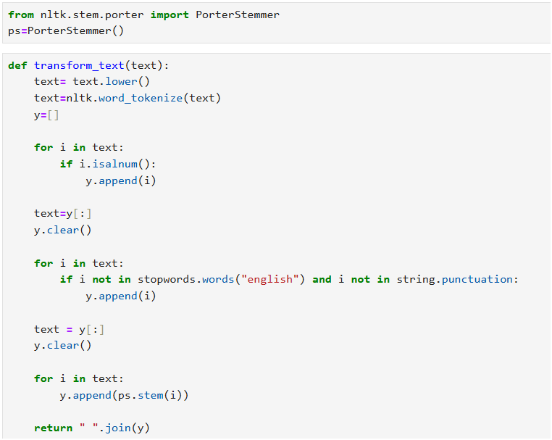

Slide 14
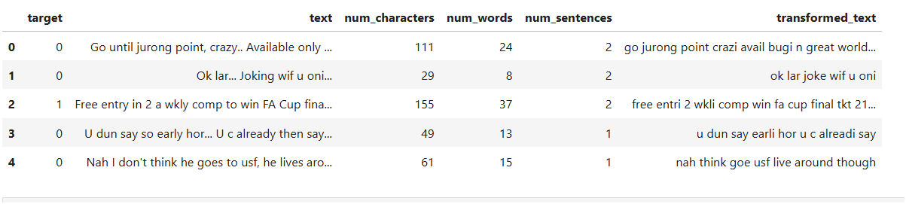

Slide 15
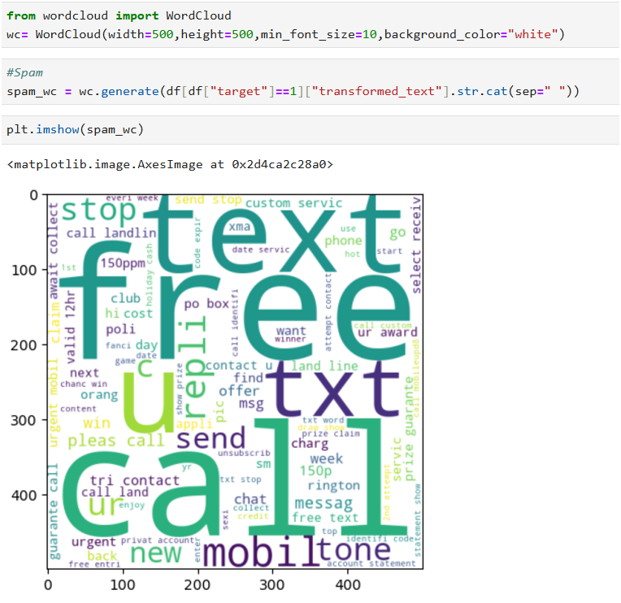
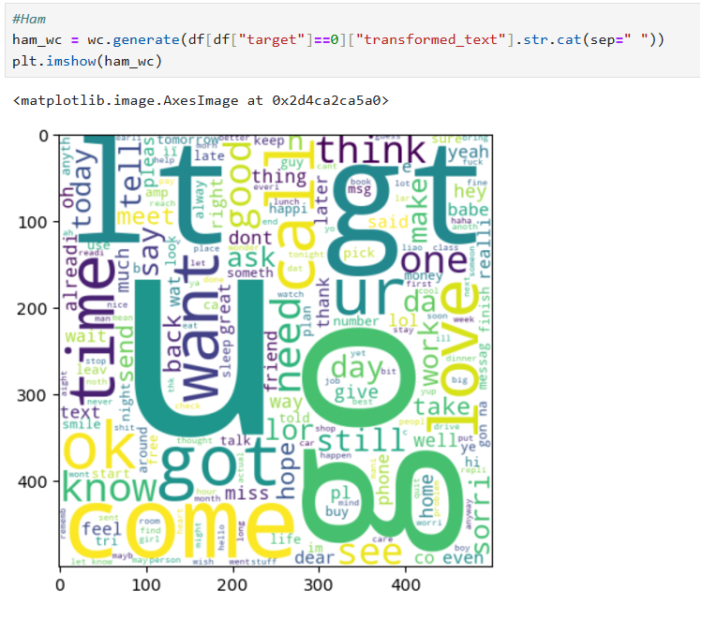
SPAM
HAM

Slide 16
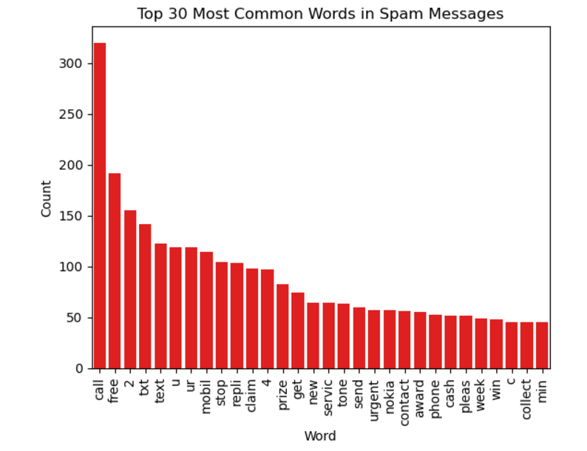
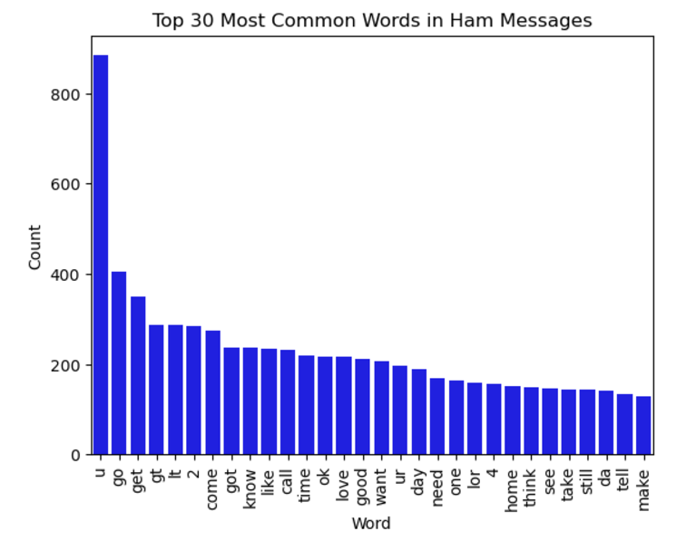

Slide 17
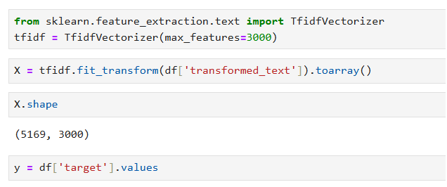
Model Building
Our model expects data to be in numeric format, but our input data is in text format. To bridge this gap, we will perform text vectorization. Specifically, we will use the TF-IDF (Term Frequency-Inverse Document Frequency) technique to convert the text into a numeric representation.

Slide 18
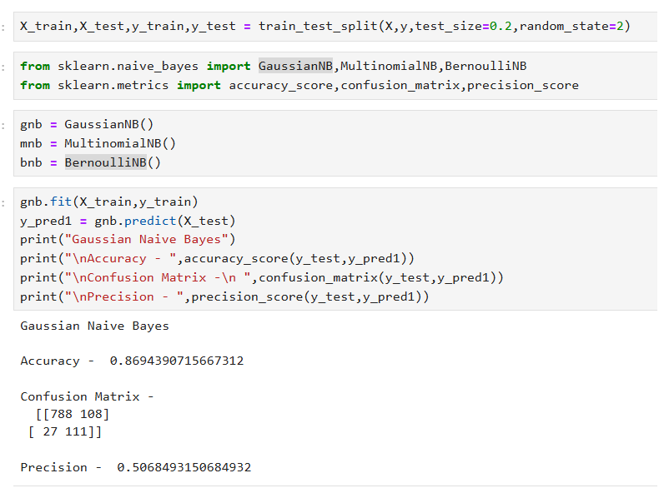
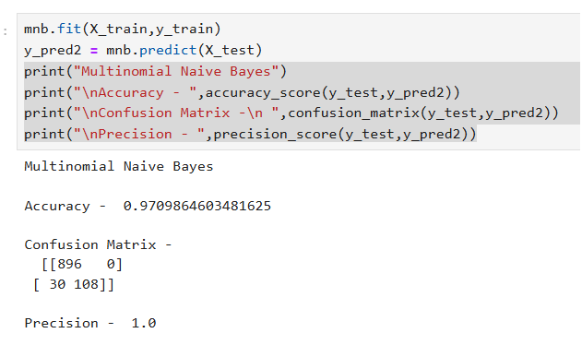
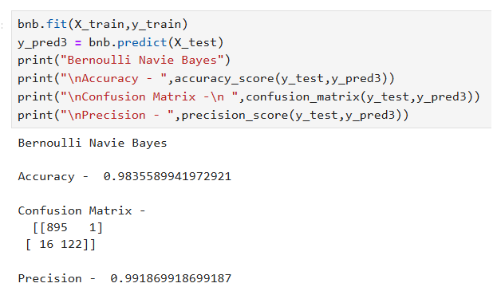
Naïve Bayes
Gaussian Naive Bayes assumes continuous data and is less effective for text, with an accuracy of 86.94% and precision of 50.68%. Multinomial Naive Bayes is well-suited for text data, achieving 97.10% accuracy and perfect precision (100%), making it ideal for this task. Bernoulli Naive Bayes, tailored for binary features, offers the highest accuracy (98.35%) and strong precision (99.19%), making it competitive but slightly behind MultinomialNB for text-based classification.

Slide 19
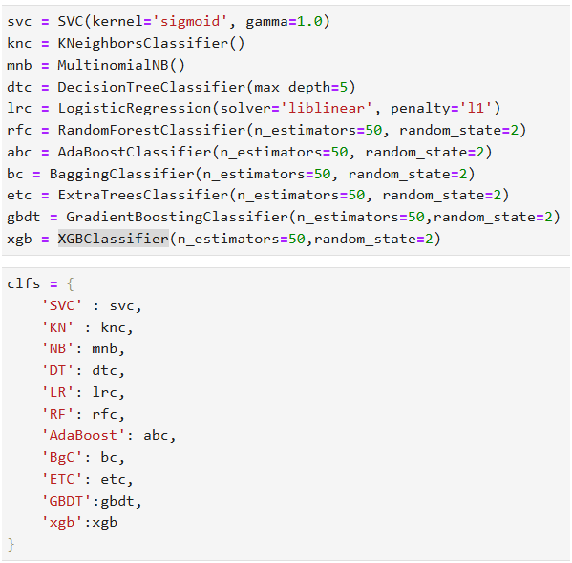
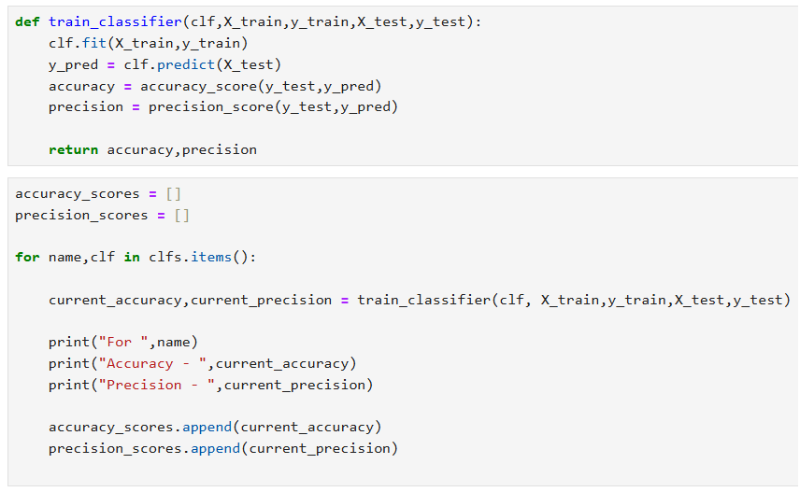
SVC, Kneighbors, MultinomialNB, DecisionTreeClassifier, LogisticRegression , RandomForestClassifier, AdaBoostClassifier, BaggingClassifier, ExtraTreesClassifier, GradientBoostingClassifier, XGBClassifier

Slide 20
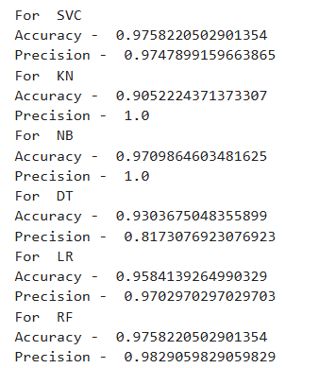
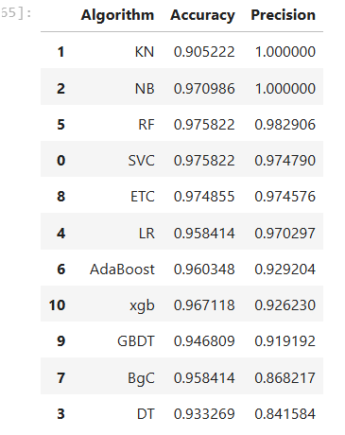
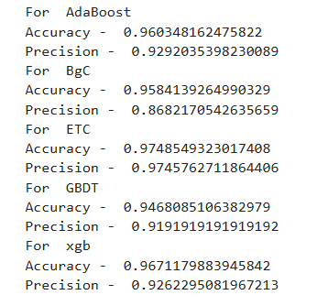
RESULT

Slide 21
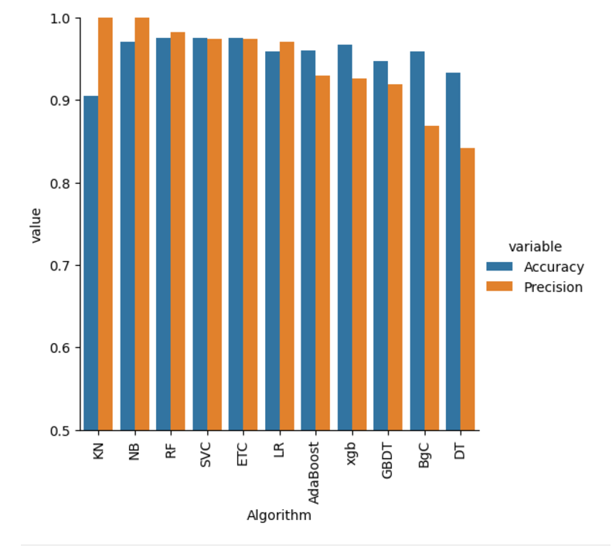
Naive Bayes (NB) and K-Nearest Neighbors (KN) achieved perfect precision (1.000), making them ideal for avoiding false positives. Random Forest (RF), SVC, and Extra Trees Classifier (ETC) delivered the best balance of accuracy (~97.5%) and precision (~0.97–0.98), suitable for robust performance. Logistic Regression (LR) is also a strong contender with high accuracy (95.8%) and interpretability. Decision Tree (DT) had the lowest precision (0.84), making it less reliable compared to others.

Slide 22
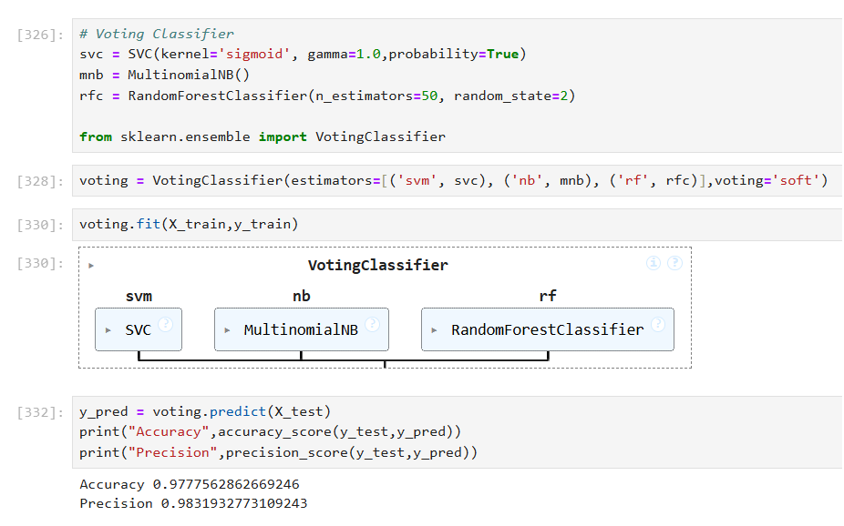
Voting Classifier
A Voting Classifier is an ensemble learning method in machine learning that combines predictions from multiple different models (also called base models or classifiers) to make a final prediction.
The precision of the Voting Classifier (0.9831) is slightly lower than the best-performing model, Naive Bayes (1.000).

Slide 23
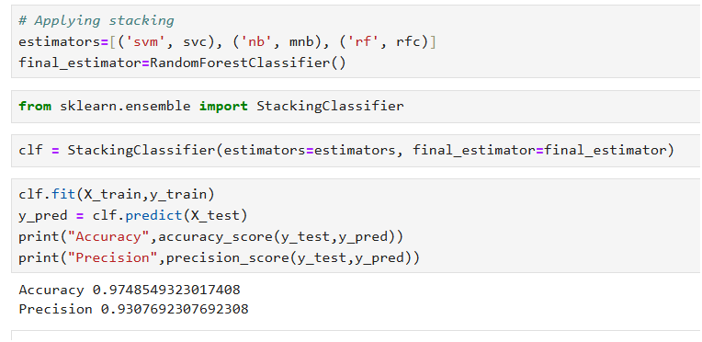
Stacking
Stacking is an ensemble learning technique that combines predictions from multiple base models (also known as level-0 models) using a meta-model (level-1 model) to make a final prediction.
The precision of stacking classifier is again very less.

Slide 24
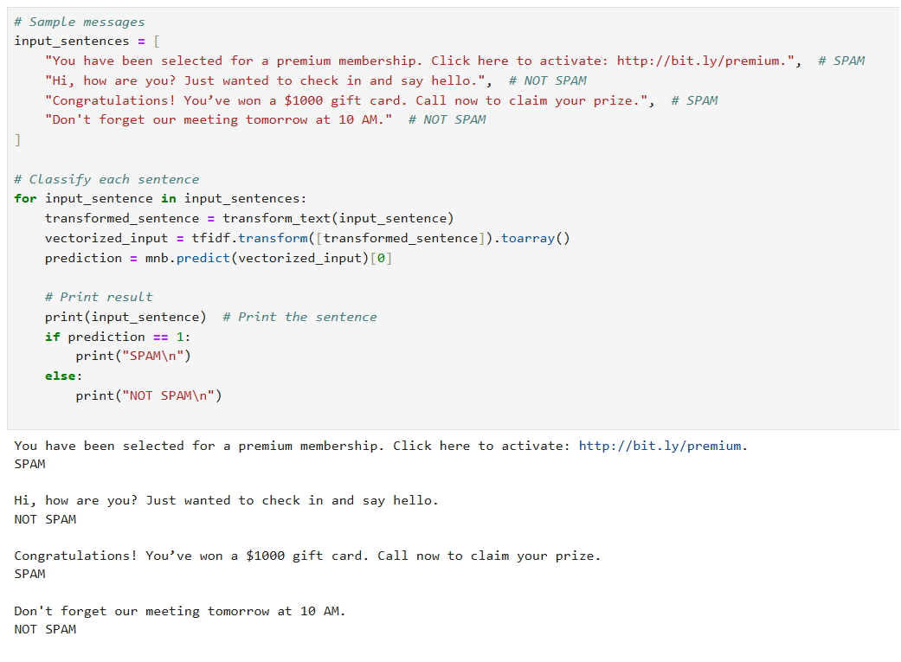
Test Final Model
Naive Bayes was selected as the final model due to its best accuracy and excellent precision. The model was tested on a few sample SMS, and it successfully classified them correctly, demonstrating its effectiveness and reliability in handling the task.

Slide 25

THANK YOU!
Any Questions?

